Slide 1
Implementing the FCTC Protocol
Guidelines for revenue authorities running tax stamp programmes
Nicola Sudan, Tim Driscoll & Ruggero Milanese
From the International Tax Stamp Association

Slide 2
28 Members
Notes:
The International Tax Stamp Association was founded in 2015 as a not-for-profit organisation that today consists of 28 members, all leading providers of components, security features, unique coding, information technology and manufacturing equipment for excise tax stamps, product authentication and secure track and trace systems for products that mainly consist of cigarettes, other tobacco products, spirits, wine, and beer.
Many countries and states across the world currently use tax stamp and track and trace systems provided by ITSA members.

Slide 3
Mission and Objectives
ITSA promotes benefits of tax stamp and secure traceability systems and advocates programme best practices by:
Facilitating collaboration and best-practice exchange
Developing and promoting tax stamp and traceability standards
Educating stakeholders
Providing common voice on benefits of tax stamp and traceability programmes

Slide 4
What is a Tax Stamp?
A visible stamp, label or mark placed on certain consumer goods to show applicable excise tax has been paid
A tool within a government’s system for collection and protection of applicable taxes
It integrates authentication and traceability features
ISO 22382:2018

Slide 5
Currently the world’s most widespread and successful mechanism to fight illicit trade
+90 COUNTRIES
120 BILLION STAMPS
Notes:
Currently, more than 90 countries use tax stamps on tobacco products, alcohol or both, with more than 80 of those countries using them on tobacco products. Based on consumption levels only, there are currently about 104 billion tax stamps used globally on cigarette packs and 14 billion on liquor/spirits.

Slide 6
WHO – FCTC Protocol

Slide 7
WHO – FCTC Protocol
Deadline for implementation of the T&T regime: Sep. 2023
Number of parties (ratifications): 68
Additional countries that have signed the FCTC convention: 168 (Convention requires each party to consider, as appropriate, developing a practical tracking and tracing regime)
Many of the parties and signatories are already running tax stamp programs for tobacco products, hence the key questions:
Can existing tax stamp programs “comply” with the Protocol? What is required?

Slide 8
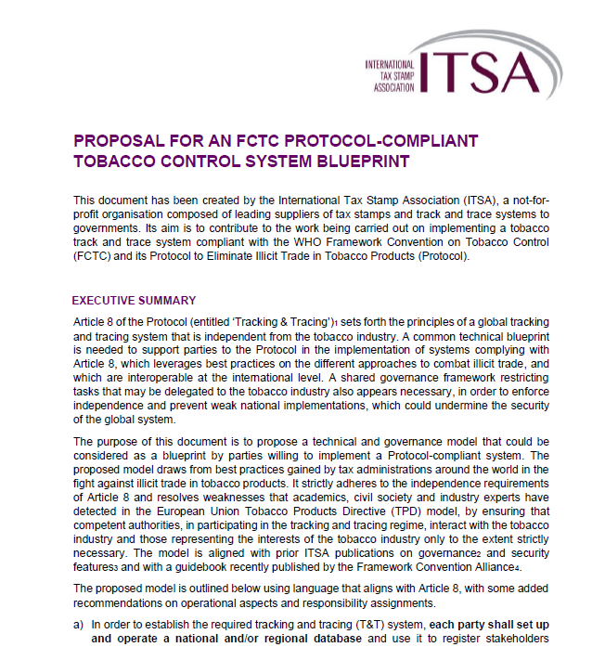
Guidelines: ITSA Blueprint
Available on the ITSA web site at:
https://www.tax-stamps.org/news-article/proposal-for-an-fctc-protocol-compliant-tobacco-control-system-blue-print
Discussed at the 2022 workshop in Malta

Slide 9
Tobacco Control System Blueprint Key Points
Tax stamp design
Database
Marking of export products
Applicable standards for Unique IDs
Production monitoring
Acceptable roles for tobacco industry
Reporting of logistics information
Enforcement programme
Global Information Sharing Focal Point

Slide 10
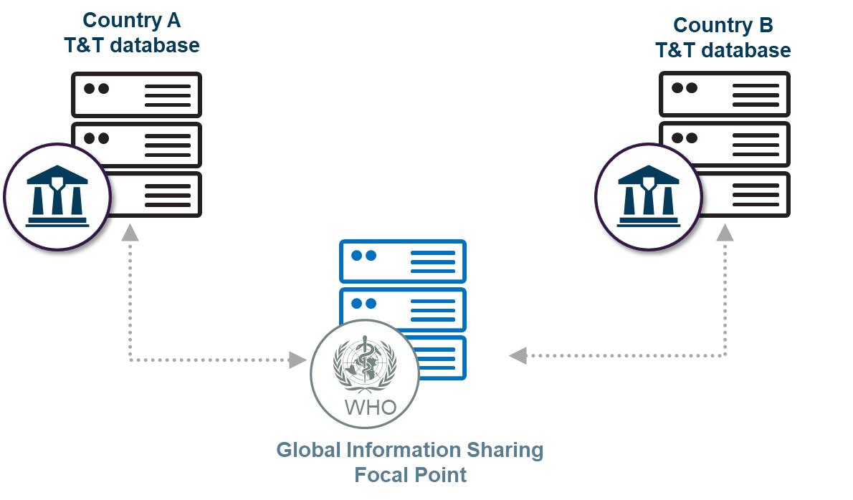
Global Information Sharing Focal Point (GSP)
Facilitation of data exchange between authorities in different countries
Retrieval of traceability information from the source/ foreign database, based on the unique IDs
Operated by the FCTC Secretariat in Geneva
Working Group mandated to issue guidelines for implementation

Slide 11
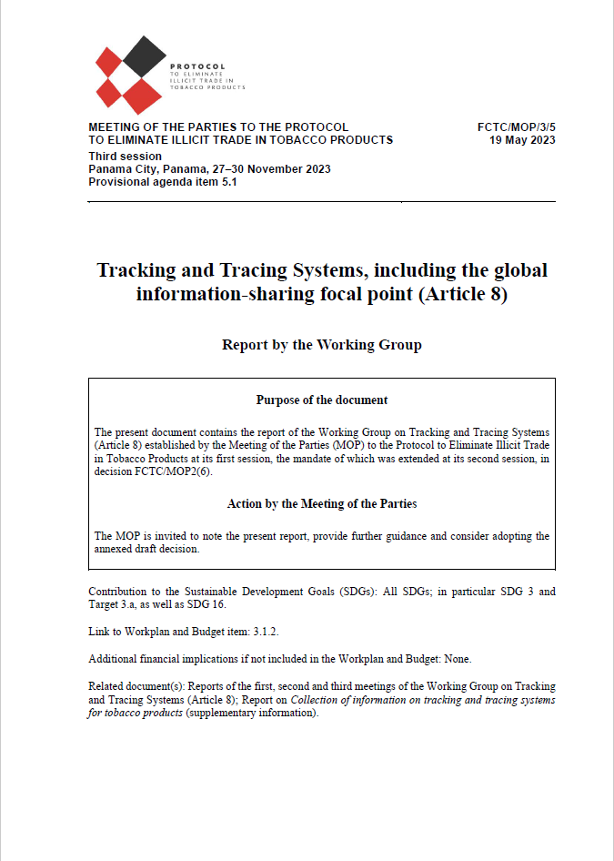
Working Group on T&T systems, including GSP
Document dated 19 May 2023, will be submitted for approval at the FCTC/MOP2 event in Nov. 2023
Minimum impact and technological neutrality
No central storage of information (query based acting as intermediary / messaging system)
Security and confidentiality via encryption and user authorization
Library of Unique ID patterns, in order to recognize the country of origin
Use-case:
Message will consist of the UIM code and information needed
The receiving party will consult their traceability system to determine if the UIM was created within their system.
If valid, the receiving party will also provide traceability data linked to that code
Further messages may be submitted with follow-up queries
In the future, more sophisticated and automated data exchange capabilities may be implemented depending on system adoption (UIM pattern detection, APIs)
https://storage.googleapis.com/protocol-mop3-source/Main%20documents/fctc-mop3-5-en.pdf

Slide 12
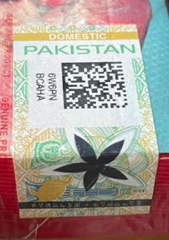
Example of how it can work with existing tax stamp programs (1 of 2)
Pakistan
Morocco
DOMESTIC
DOMESTIC
✓
✓
UID_{PAK}
UID_{MOROCCO}

Slide 13
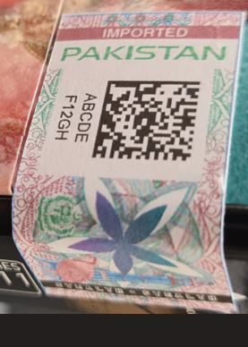
Example of how it can work with existing tax stamp programs (1 of 2)
Pakistan
Morocco
DOMESTIC
IMPORT
EXPORT
DOMESTIC
✓
✓
✓
UID_{PAK}
UID_{PAK}
UID_{MOROCCO}

Slide 14
Example of how it can work with existing tax stamp programs (2 of 2)
Pakistan
Morocco
Country: Morocco
UID = “ABC”
TAX STAMP: MOROCCO (illegal in Pakistan)
UID

Global Information Sharing Focal Point

Slide 15
Example of how it can work with existing tax stamp programs (2 of 2)
Pakistan
Morocco
?
Assistance & Cooperation (Art. 24)
✓
UID valid: yes
Product brand: B1
Manufacturer: XYZ
Date: 00-00-0000
…
TAX STAMP: MOROCCO (illegal in Pakistan)
Global Information Sharing Focal Point

Slide 16
Key takeaways for existing tax stamp programs
Existing tax stamp programs can technically comply and participate in the global WHO T&T regime, provided that:
Tax stamps have unique IDs, complying with globally unique numbering schemes, e.g. through a country-specific prefix (ISO 15459): «Country-Prefix» + «X₁X₂X₃X₄….»
Prefix can be requested by the revenue authority to AIM, or can use ITSA’s prefix (WAA)
Short-term workaround: the identity of the target country is clearly visible on the stamp («pattern»)
The T&T database records detailed activation information associated to each ID (manufacturer, brand, date of manufacturing, etc.) and has search capabilities
No products should be manufactured in the country unmarked → require «export» stamp aimed for destination countries that do not use a tax stamp
MORE INFORMATION CAN BE FOUND IN THE «ITSA FCTC BLUEPRINT»

Slide 17
Membership
Talk to us about joining ITSA
Email: info@tax-stamps.org
www.tax-stamps.org
Associate Membership opportunity for Revenue Authorities (free of charge)
Notes:
If you are a tax or customs authority that would like to join forces with us, we have recently set up an associate membership category, more details of which are available on our website, together with an application form.
But in a nutshell, associate members will represent the views of government authorities and institutions involved in tax stamp issuance and excise product control by participating in discussions and influencing some of the decisions made and activities carried out by ITSA. Another important benefit for associate members is that they will be able to form a closer relationship with a neutral, non-partisan body that represents leading tax stamp and secure track and trace producers that are independent from economic operators of excisable products.

